Slide 1
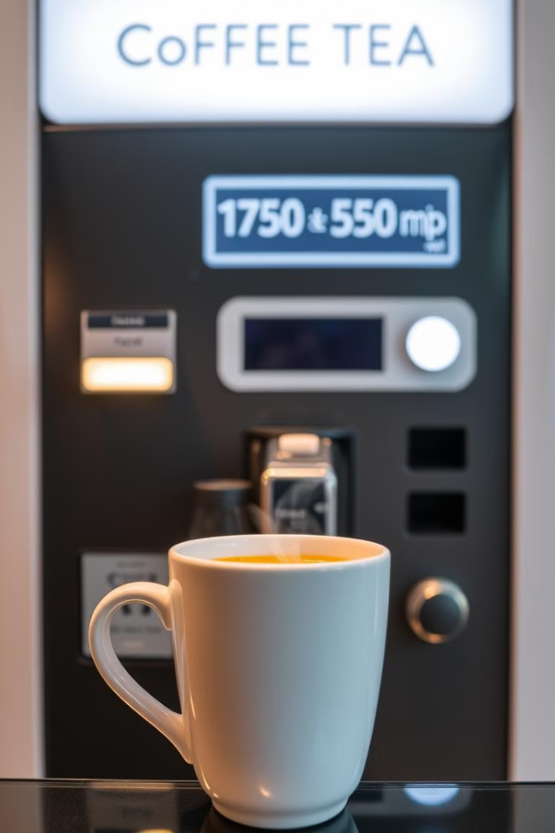
Coffee and Tea Vending Machine
Presented by Tooba Aziz(23BSCS029) & Shamama Nizamani(23BSCS010)

Slide 2
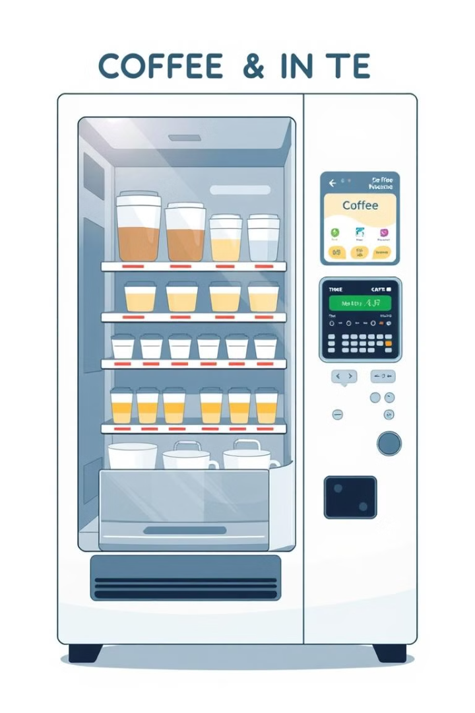
Vending Machine
A vending machine is an automated device that dispenses items like snacks, drinks, or other small products when money is inserted or a digital payment is made. These machines are commonly found in public spaces like schools, malls, hospitals, and offices, offering a convenient way to purchase goods without needing a cashier.

Slide 3
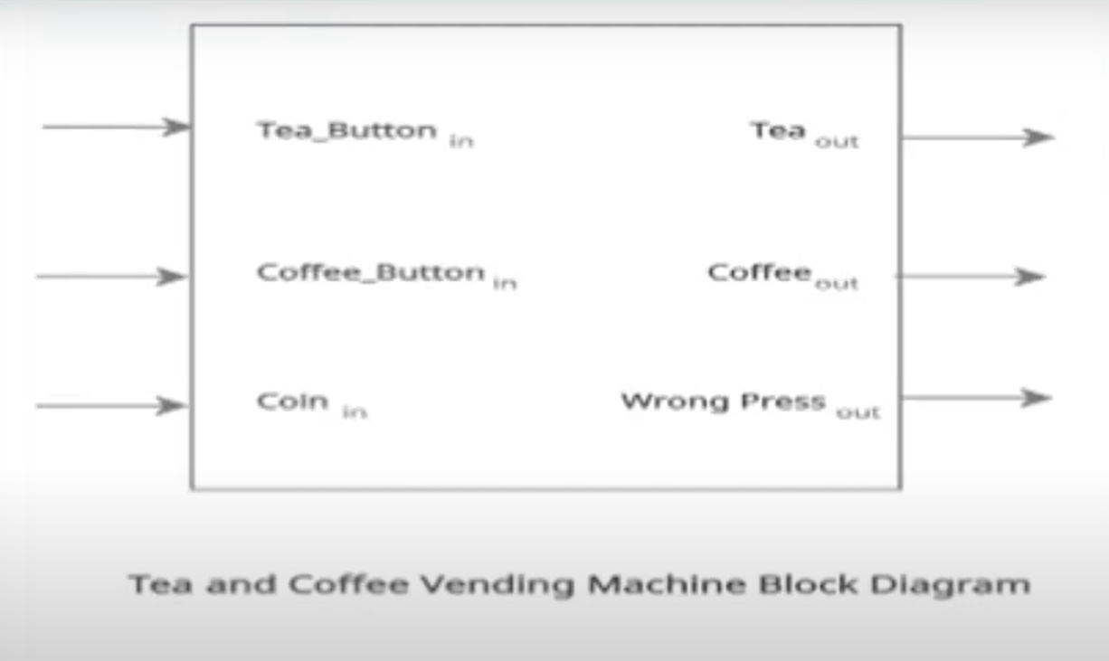
Block Diagram

Slide 4
Circuit Design
The circuit design incorporates input switches for Coffee (C), Tea (T), and Coin (CO) to simulate user selections. Each switch can be toggled between 1 (ON) and 0 (OFF), representing the user's choice.
Output LEDs are used to indicate the dispensed beverage. LEDs for Coffee Output (COF) and Tea Output (TEA) illuminate to show the selected drink. An Invalid Selection (IS) LED lights up when an incorrect selection is made, such as choosing both coffee and tea.
Logic gates are used to process user input. An AND gate determines if a coin has been inserted alongside a coffee or tea selection. An OR gate detects an invalid selection when both coffee and tea are selected simultaneously. A NOT gate negates the invalid selection output.

Slide 5
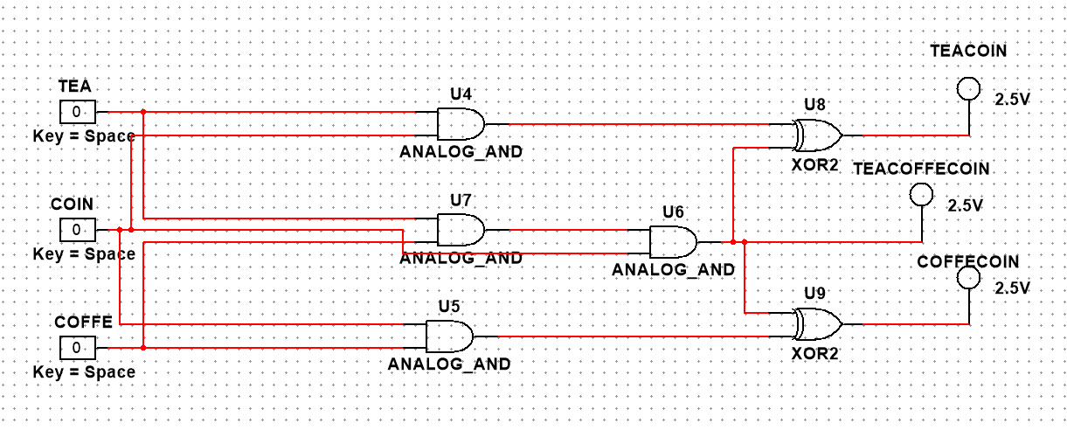
Circuit Design

Slide 6
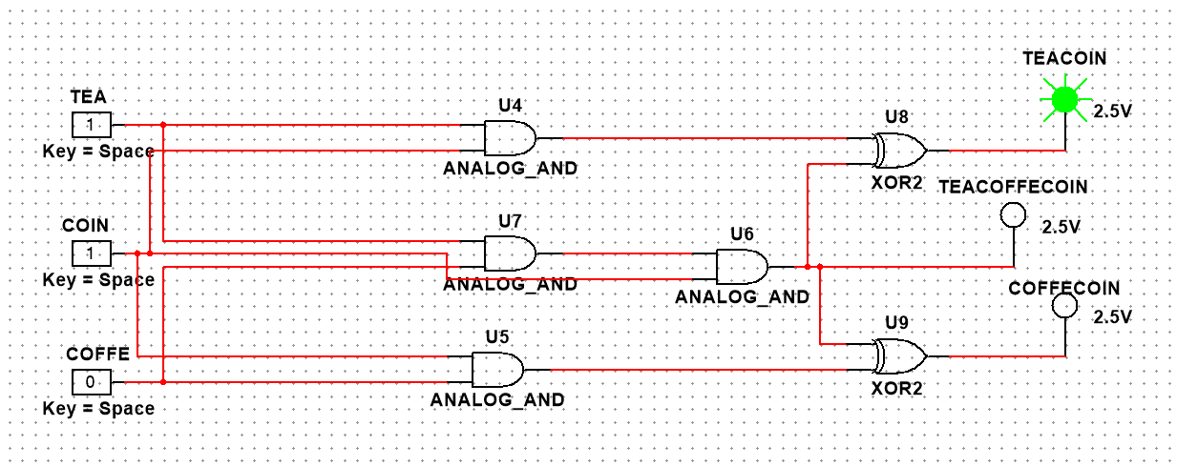
Circuit Design

Slide 7
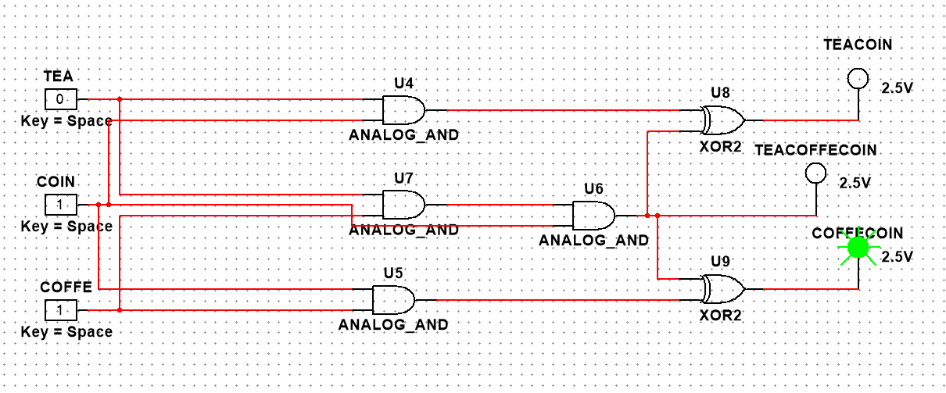
Circuit Design

Slide 8
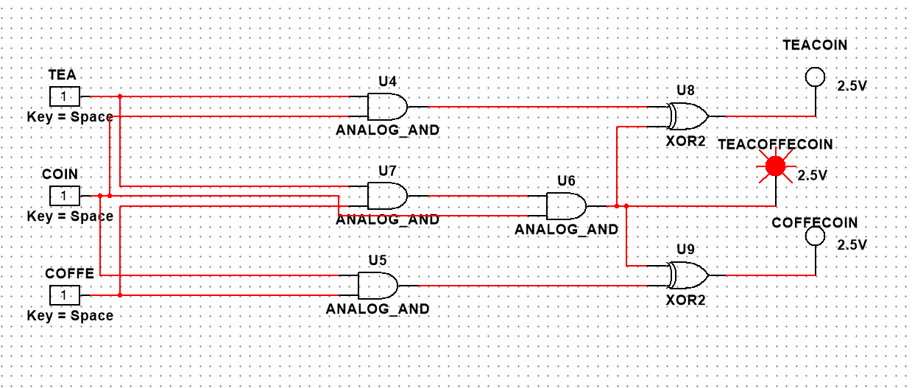
Circuit Design

Slide 9
Inputs
Coffee Selection (C): This input signal is set to '1' when the user selects coffee and '0' otherwise. The signal is triggered by pressing the coffee button on the machine.
Tea Selection (T): This input signal is set to '1' when the user selects tea and '0' otherwise. The signal is triggered by pressing the tea button on the machine.
Coin Insertion (CO): This input signal is set to '1' when a coin is inserted into the vending machine and '0' otherwise. The signal is detected by a coin sensor.
Outputs
Coffee Output (COF): This output signal is set to '1' when the vending machine dispenses coffee and '0' otherwise. The signal triggers the release of coffee from the dispensing mechanism.
Tea Output (TEA): This output signal is set to '1' when the vending machine dispenses tea and '0' otherwise. The signal triggers the release of tea from the dispensing mechanism.
Invalid Selection (IS): This output signal is set to '1' when an invalid selection occurs, such as selecting both coffee and tea, or selecting a beverage without inserting a coin. The signal triggers an error message on the machine display.

Slide 10
Truth Table
C (Coffee)
T (Tea)
CO (Coin)
COF (Coffee Output)
TEA (Tea Output)
IS (Invalid Selection)
0
0
0
0
0
0
0
0
1
0
0
0
0
1
0
0
0
0
0
1
1
0
1
0
1
0
0
0
0
0
1
0
1
1
0
0
1
1
0
0
0
1
1
1
1
0
0
1

Slide 11
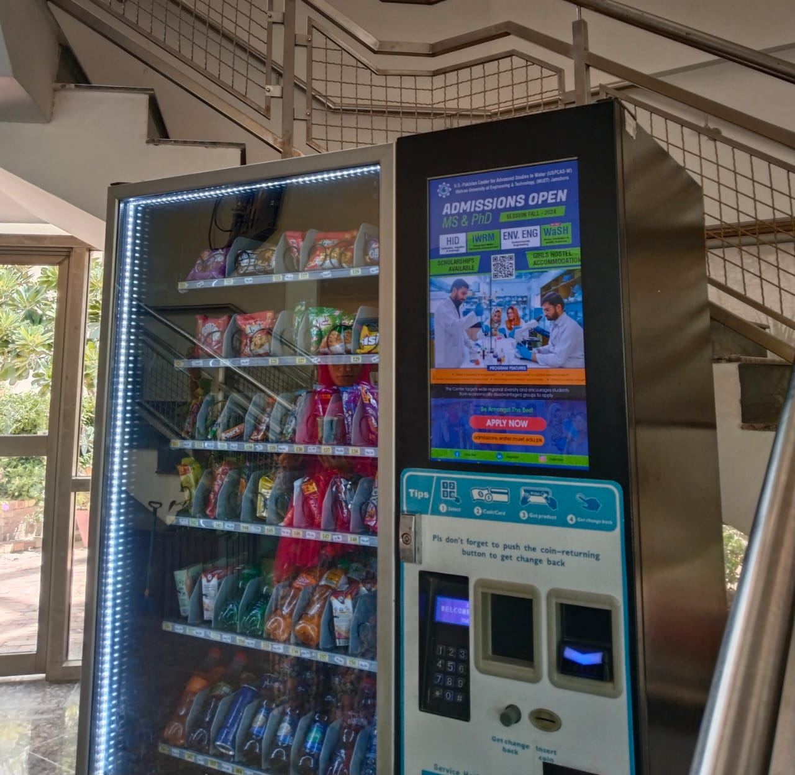
Conclusion and Future Enhancements
Conclusion
Future Enhancements
The project successfully designed and implemented a coffee and tea vending machine that meets the specified goals and objectives.
Potential future enhancements include adding features like flavor options, contactless payment methods, and a digital display showing the remaining balance.

